Slide 1
Education System in Pakistan
Challenges and Solutions
By : Haris Ahmad

Slide 2
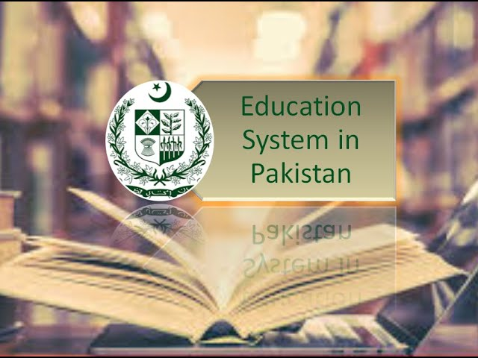
Introduction
Purpose of the presentation:
To highlight the challenges faced by
the education system in Pakistan and propose
potential solutions.

Slide 3
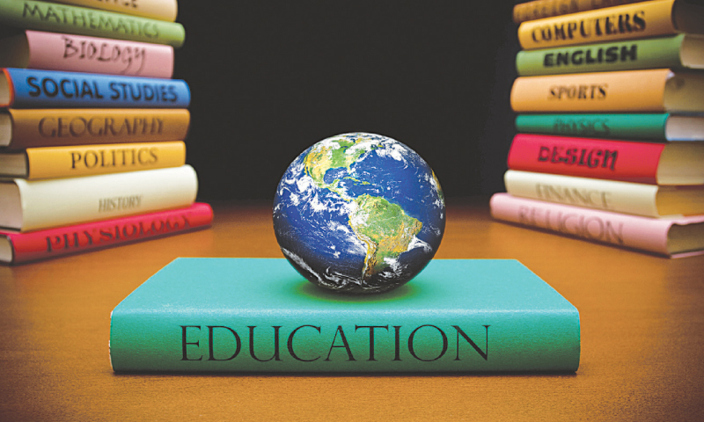
Importance of Education
Emphasize the significance of education for the individual and the nation
Education as a tool for personal development, social mobility, and economic growth

Slide 4

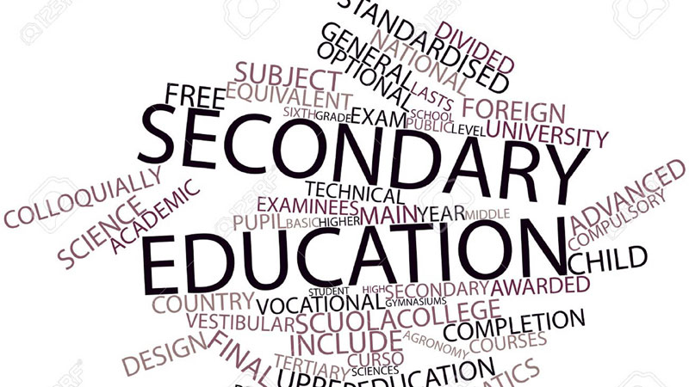

Structure of education in pakistan
Primary Education
Secondary Education
Tertiary Education
Primary education focuses on foundational knowledge and skills.
Secondary education is based upon the foundations and provides a broader curriculum.
Tertiary education offers specialized and advanced studies at the university and college level.

Slide 5
Challenges faced by the education system
Access to Education
Education Financing
Social and Cultural Barriers
Limited access to quality education, particularly in rural areas.
Gender disparity and low enrollment rates, especially among girls.
Insufficient infrastructure and lack of schools in remote areas.
Inadequate funding for education sector.
Unequal distribution of resources among provinces and districts.
Limited government spending on education compared to international standards.
Socio-cultural norms discouraging girls' education.
Early marriages and child labor affecting attendance and retention rates.
Lack of awareness about the importance of education in some communities.

Slide 6
Solutions to address the challenges
Access to Education
Education Financing
Social and Cultural Barriers
Increase the number of schools in underserved areas.
Develop innovative models such as mobile schools or community learning centers.
Implement targeted policies to promote enrollment of girls and marginalized groups.
Increase government spending on education to meet international standards.
Ensure equitable distribution of resources among provinces and districts.
Encourage public-private partnerships to bridge funding gaps.
Launch awareness campaigns to promote the importance of education.
Engage religious leaders and community influencers to advocate for girls' education.
Enforce laws against child labor and early marriages to protect children's right to education.

Slide 7

conclusion
Recap the challenges faced by the education system in Pakistan.
Emphasize the importance of addressing these challenges for the country's progress.

